Slide 1
Typst Render
Quarto Extension Mickaël CANOUIL, Ph.D.

Slide 2
A Quarto filter extension that compiles ```{typst} code blocks to images (PNG, SVG, or PDF) using the Typst binary bundled with Quarto. This makes Typst diagrams, figures, tables, and equations usable across all output formats (HTML, PDF via LaTeX, DOCX, RevealJS, and more).
When the output format is Typst, blocks pass through natively without image conversion.

Slide 3
Installation
quarto add mcanouil/quarto-typst-render@0.5.0
This will install the extension under the _extensions subdirectory.
If you are using version control, you will want to check in this directory.

Slide 4
Usage
To use the extension, add the following to your document’s front matter:
filters: - typst-render
For cross-referencing support, use timing control:
filters: - path: typst-render at: pre-quarto
Then write Typst code blocks in your document:
```{typst} #set text(size: 16pt) Hello from *Typst*! ```

Slide 5
Basic Usage
A simple Typst block rendered as an image:
```{typst} #set text(size: 16pt) Hello from *Typst*! This is rendered as an image in non-Typst outputs. ```

Slide 6

Per-Block Options
Use comment+pipe syntax (//| key: value) at the top of the code block to set per-block options.
Page Dimensions
Control the width, height, and margin of the rendered image page. These options set the Typst page dimensions for image compilation (non-Typst output formats). In native Typst output, width and height are ignored; margin is applied as block inset.
```{typst} //| width: 12cm //| height: auto //| margin: 1em #set text(size: 14pt, fill: eastern) #align(center)[ #box( fill: luma(240), inset: 1em, radius: 4pt, )[A styled box with custom dimensions.] ] ```

Slide 7

Image Format and DPI
Set the output image format and resolution:
```{typst} //| format: png //| dpi: 288 #set text(size: 14pt) #align(center)[High-resolution PNG output.] ```

Slide 8
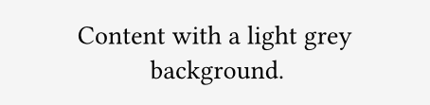
Background Colour
Set a fill colour for the rendered image page. In native Typst output, the colour is applied as block fill.
```{typst} //| background: luma(245) //| width: 8cm //| margin: 1em #set text(size: 14pt) #align(center)[ Content with a light grey background. ] ```

Slide 9

Cross-Referencing
Use //| label: and //| cap: for Quarto cross-references. Generic cap and alt options work with any label prefix. Prefix-specific variants (e.g., fig-cap, tbl-alt) override the generic options when the label matches. Any Quarto cross-reference type is supported (fig-, tbl-, lst-, etc.), including custom types.
See Figure 1 for a captioned figure.
```{typst} //| label: fig-typst-shapes //| cap: "A simple Typst diagram with shapes." //| alt: "A blue circle and orange rectangle arranged horizontally." #set text(size: 12pt) #align(center)[ #stack(dir: ltr, spacing: 1em)[ #circle(radius: 1cm, fill: blue.lighten(60%)) ][ #rect(width: 2cm, height: 2cm, fill: orange.lighten(60%)) ] ] ```
Figure 1: A simple Typst diagram with shapes.

Slide 10
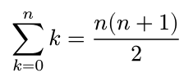
Echo and Eval Control
The echo and eval options control whether source code is displayed and whether the block is compiled.
Echo: Source Code Alongside Output
Show the source code followed by the rendered output with echo: true:
#set text(size: 14pt) $ sum_(k=0)^n k = (n(n+1))/2 $

Slide 11

Echo: Fenced Source Code
Use echo: fenced to display source code wrapped in fenced code block markers (```{typst}), including any comment+pipe options (except echo itself). This mirrors Quarto’s native echo: fenced behaviour for computational cells.
```{typst} #set text(size: 14pt) $ integral_0^infinity e^(-x) d x = 1 $ ```

Slide 12
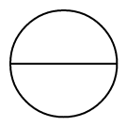
Eval: Source Only (No Compilation)
Display the source code without compiling with eval: false:
```{typst} //| eval: false #import "@preview/cetz:0.4.2": canvas, draw #canvas({ draw.circle((0, 0), radius: 1) draw.line((-1, 0), (1, 0)) }) ```
With eval: true (the default), the block is compiled:
```{typst} //| eval: true #import "@preview/cetz:0.4.2": canvas, draw #canvas({ draw.circle((0, 0), radius: 1) draw.line((-1, 0), (1, 0)) }) ```

Slide 13
Hidden Block
Setting eval: false and echo: false hides the block entirely. Nothing is rendered.
Include: Suppress All Output
Setting include: false suppresses all output (both source and rendered image). The block is completely hidden from the document, regardless of other options.
Output: Suppress Rendered Output
Setting output: false skips compilation and suppresses the rendered image. When combined with echo: true, only the source code is shown.
#set text(size: 14pt) This source is visible, but the rendered image is suppressed.

Slide 14
Output Location (Reveal.js)

Slide 15

Input Variables
Pass key-value pairs to Typst code via sys.inputs. Global inputs are set in YAML; per-block inputs override them using comma-separated syntax.
```{typst} //| input: greeting=Hello,subject=World #set text(size: 16pt) #sys.inputs.at("greeting"), #sys.inputs.at("subject")! ```

Slide 16
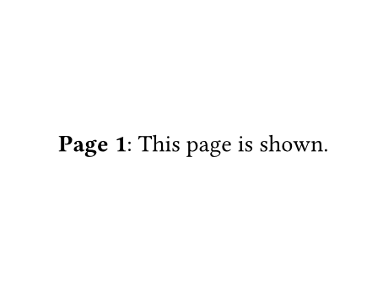
Multi-Page Output
When Typst produces multiple pages, all pages are included by default. Use pages to select specific pages and layout-ncol to arrange them in columns.
All Pages Side by Side
```{typst} //| layout-ncol: 2 //| width: 8cm //| height: 6cm #set text(size: 14pt) #align(center + horizon)[ *Page 1*: First page content. ] #pagebreak() #align(center + horizon)[ *Page 2*: Second page content. ] ```
First Page Only
```{typst} //| pages: 1 //| width: 8cm //| height: 6cm #set text(size: 14pt) #align(center + horizon)[ *Page 1*: This page is shown. ] #pagebreak() #align(center + horizon)[ *Page 2*: This page is hidden. ] ```

Slide 17
External File Rendering
Render an external .typ file instead of inline code:
```{typst} //| file: _extensions/typst-render/_example.typ #set text(size: 14pt) #align(center)[ This content was loaded from an external `.typ` file. ] ```

Slide 18
Preamble
Typst code can be prepended before each block using the preamble option. This is useful for setting global styles or importing packages.
Inline Preamble
extensions: typst-render: preamble: '#set text(font: "Libertinus Serif")'
File-Based Preamble
Any value ending in .typ is treated as a file path:
extensions: typst-render: preamble: "preamble.typ"

Slide 19
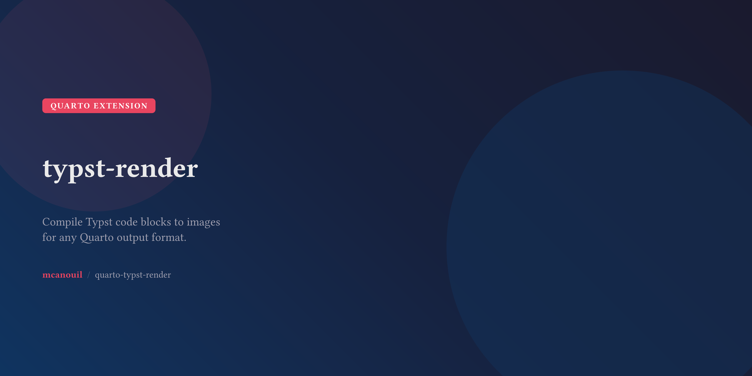
Social Card
A repository social card built entirely in Typst, rendered as a high-resolution PNG.
```{typst} //| label: fig-social-card //| cap: "Social card for quarto-typst-render." //| format: png //| dpi: 288 //| width: 1280pt //| height: 640pt //| margin: 0pt #let gradient-bg = gradient.linear( rgb("#1a1a2e"), rgb("#16213e"), rgb("#0f3460"), angle: 135deg, ) #let accent = rgb("#e94560") #let text-primary = rgb("#eaeaea") #let text-secondary = rgb("#a0a0b0") #let surface = rgb("#1a1a2e").lighten(10%) #set page(fill: gradient-bg) #set text(font: "Inter", fill: text-primary) #place( top + left, dx: -40pt, dy: -40pt, circle(radius: 200pt, fill: accent.transparentize(92%)), ) #place( bottom + right, dx: 80pt, dy: 80pt, circle(radius: 300pt, fill: rgb("#0f3460").transparentize(60%)), ) #align(horizon)[ #pad(x: 72pt)[ #grid( columns: (1fr, auto), column-gutter: 48pt, align: (left + horizon, right + horizon), [ #block( fill: accent, radius: 6pt, inset: (x: 14pt, y: 8pt), )[ #text( size: 14pt, weight: "bold", tracking: 1.5pt, fill: white, )[QUARTO EXTENSION] ] #v(20pt) #text(size: 48pt, weight: "bold", tracking: -0.5pt)[ typst-render ] #v(12pt) #text(size: 20pt, fill: text-secondary, weight: "regular")[ Compile Typst code blocks to images#linebreak() for any Quarto output format. ] #v(28pt) #text(size: 16pt, fill: text-secondary)[ #text(fill: accent, weight: "bold")[mcanouil] #h(4pt) #text(fill: text-secondary.transparentize(50%))[/] #h(4pt) quarto-typst-render ] ], ) ] ] ```
Figure 2: Social card for quarto-typst-render.

Slide 20
Global Configuration
Option | Type | Default | Description
format | string | (auto) | Image format: png, svg, pdf.
dpi | string | "144" | Pixels per inch (PNG only).
width | string | "auto" | Page width for image compilation (ignored in Typst output).
height | string | "auto" | Page height for image compilation (ignored in Typst output).
margin | string | "0.5em" | Page margin for image compilation; block inset in Typst output.
background | string | "none" | Page fill for image compilation; block fill in Typst output.
preamble | string | "" | Typst code or path to a .typ file prepended before user code.
cache | boolean|string | true | Cache compiled images. Use "clean" to also remove stale cache files.
input | object | (none) | Key-value pairs passed as --input flags to Typst CLI.
file | string | (none) | Path to external .typ file to render.
echo | boolean|string | false | Show Typst source code alongside output (true, false, fenced).
eval | boolean | true | Compile Typst code to image.
include | boolean | true | Include block in output. Set false to suppress entirely.
output | boolean | true | Show rendered output. Set false to skip compilation.
output-location | string | (none) | Output placement in Reveal.js (fragment, slide, column, column-fragment).
classes | string | (none) | Space-separated CSS classes on the output image (e.g., r-stretch).
pages | string | "all" | Pages to include from multi-page output: all, 1, 1-3, 2,5, 3-.
layout-ncol | string | (none) | Number of columns for arranging multi-page output. Omit for vertical stack.
Configure the filter globally in your document YAML. Most options can be set globally and overridden per block using comment+pipe syntax (//| key: value). See Global-Only Options for options that cannot be overridden per block.
extensions: typst-render: dpi: "288" margin: "1em" format: png cache: true
Options

Slide 21
Option | Type | Default | Description
root | string | (project directory) | Root directory for Typst compilation.
font-path | string|array | (none) | Path or list of paths to directories containing additional fonts.
package-path | string | (none) | Path to a directory containing Typst packages (offline/reproducible).
Any unknown option with a string value is forwarded as an HTML attribute on the output image element (e.g., //| style: "max-height: 300px;"). Values that look like booleans (true/false) must be quoted to be forwarded (e.g., //| data-lazy: "true").
Global-Only Options
These options can only be set in the document YAML and cannot be overridden per block.

Slide 22
Option | Type | Description
label | string | Quarto cross-ref label (e.g., fig-x, tbl-y, lst-z).
cap | string | Caption text for the labelled block.
alt | string | Alternative text for accessibility.
<prefix>-cap | string | Prefix-specific caption (e.g., fig-cap). Overrides cap for matching labels.
<prefix>-alt | string | Prefix-specific alt text (e.g., fig-alt). Overrides alt for matching labels.
Per-Block Cross-Referencing Options

Slide 23
Output Format | Default Image Format
HTML / RevealJS | svg
LaTeX / Beamer | pdf
Typst | (native pass-through)
DOCX / PPTX | png
Other | png
Auto-Selected Image Format

Slide 24
eval | echo | Result
true | false | Image only (default).
true | true | Source code block + image below.
true | fenced | Fenced source code block (with markers) + image.
false | true | Source code listing only.
false | fenced | Fenced source code listing only (with markers).
false | false | Nothing rendered (hidden block).
Echo/Eval Behaviour

Slide 25
The include and output options take precedence over the eval/echo matrix:
include: false hides the entire block regardless of eval/echo settings.
output: false skips compilation and shows only the source code (if echo is enabled).

